Slide 1
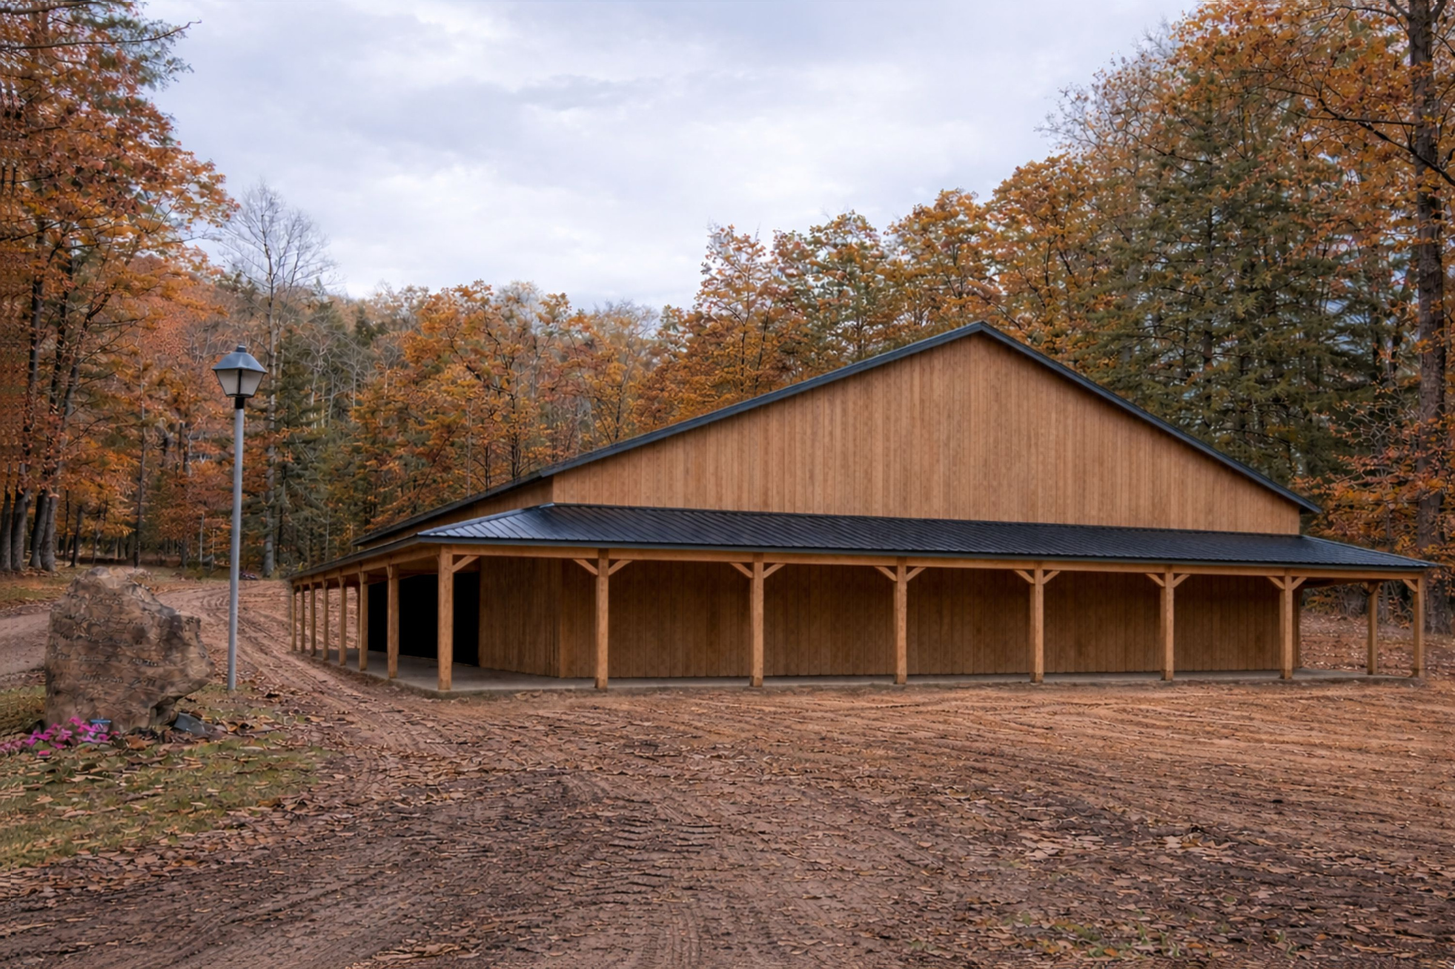
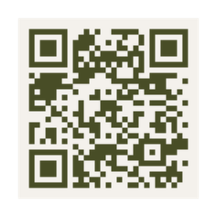

ISAIAH 59:21
Mahaffey Camp & Conference Center
Youth Tabernacle Fund
*This image is a virtual rendering. The final Youth Tabernacle design may differ.

